Slide 1
205 Oct 9, Class 7
Gino & Wiltermuth (2014)
Chapter 7: Within-participant designs
  History effects as an extraneous variable

Slide 2
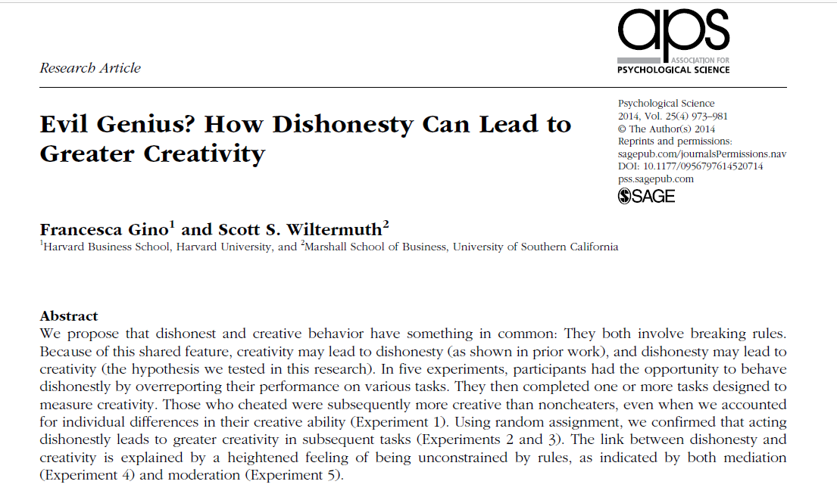

Slide 3
Q1. Across the first three studies, what construct does the independent variable aim to capture?
Q3. What is the common operational definition of creativity used as the dependent variable across the first three experiments?

Slide 4
Operational definitions
Creativity
  Remote Associates Test (RAT)
  What is the common word that links
    Sore, Shoulder, Sweat
    Opera, Hand, Dish
    Piece, Mind, Dating
Dishonesty
  Experimentally controllable (or measurable) cheating or lying

Slide 5
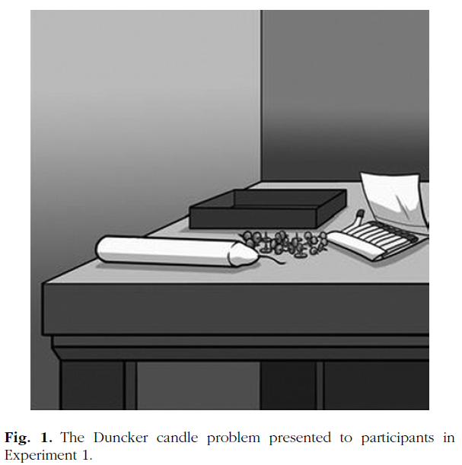
Experiment 1
Procedure
  Dunker candle problem
  Filler/cheatable task
    10 matrices
    Self-reported performance, paid
  RAT performance
Results
  Cheaters performed better on the RAT test
  No random assignment to the cheating condition here

Slide 6
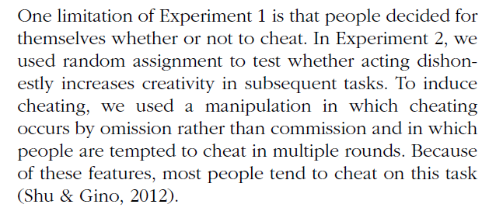
Experiment 2
How do you experimentally control cheating to be able to randomly assign participants to the “cheating” and control conditions?
  Operational definition of this IV

Slide 7
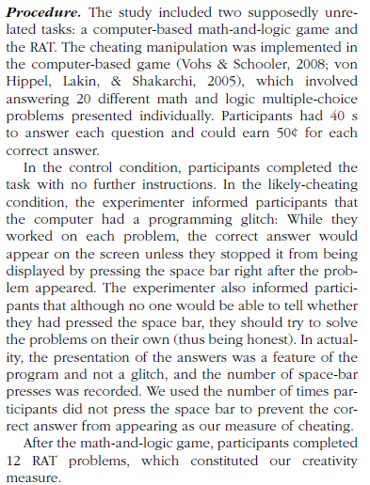
IV
DV

Slide 8
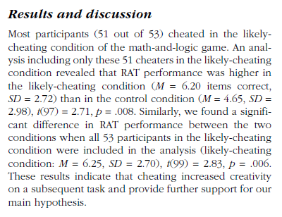
Effect size:
  6.20 vs 4.65 problems solved
  = 1.55 more
2 independent samples t-test

Slide 9
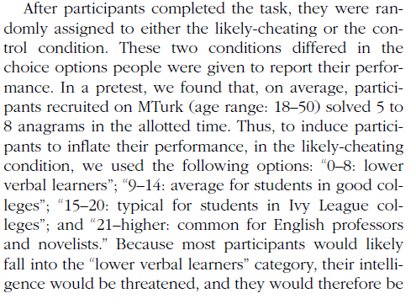
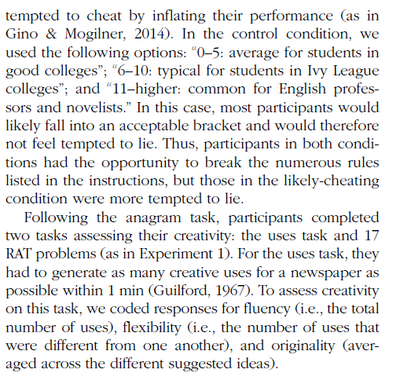
Gino & Wiltermuth (2014)
In Experiment 3, what is the IV changed to and why?

Slide 10
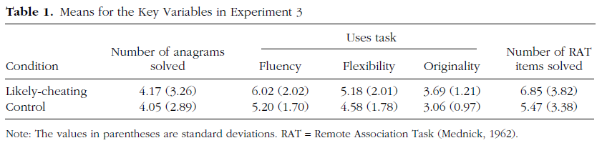
Exp 3 Results
Alternate hypothesis for Exp 3?
Ethical questions about this research?

Slide 11
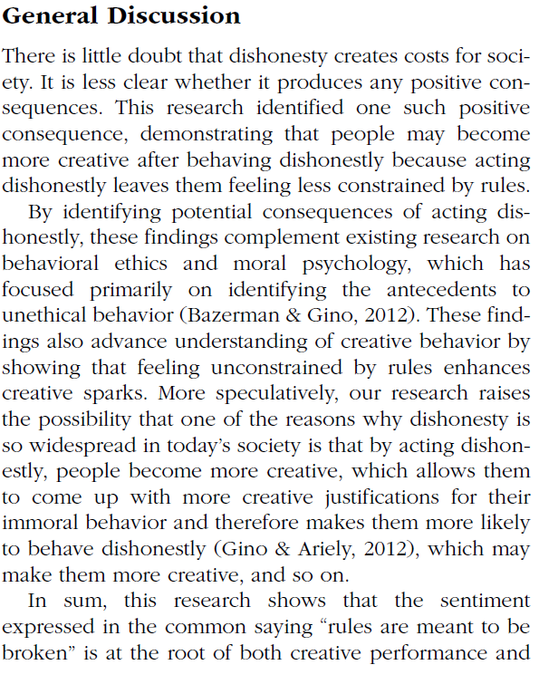

Conclusions
From the General Discussion, how do the authors explain the overall set of their findings with respect to the theoretical relationship between dishonesty and creativity via a mechanism? Give an example of a speculative point made that goes beyond the statement of results.

Slide 12
In an effort to determine the effects of the drug chlorpromazine on the cognitive performance of schizophrenics, two clinical investigators randomly selected 20 acute schizophrenics from a mental hospital population.
The patients were asked to order several stimuli along some dimension, such as ordering eight stimuli by weight.
There were several tasks of this sort.
The investigators used a within-participant design in which all participants first performed the tasks after being injected with a saline solution (placebo) and then performed the tasks again several hours later after being injected with chlorpromazine.
The results indicated that fewer errors were made in the chlorpromazine treatment, which suggested to the investigators that the drug facilitates more adequate cognitive functioning in this type of patient.

Slide 13
Jones wondered if infants might begin the social control of facial expressions, including smiles even earlier than 18m. A laboratory testing situation was set up to observe 10m-old babies with their mothers. Two conditions were tested. In one, the mother paid attention to the baby for 6 min; in the other she read a magazine for 6 min. The baby was videotaped and smiles were later scored by judges who viewed the tapes. Babies smiled at their mothers more often when their mothers were attentive.

Slide 14
 | Mom watching | Mom reading
SN | 12 | 6
JF | 8 | 7
KM | 4 | 3
GB | 2 | 0
SB | 18 | 15
Avg | 8.8 (2.9) | 6.2 (2.5)

Slide 15
Smiling
Two-sample t-test assuming equal variances, t(8)=0.69, p>0.65

Slide 16
Smiling
Paired t-test, t(4)=2.83, p< .05

Slide 17
Within-participants design
Generally better
  Except when it’s not
Advantages
  Highly efficient. Each participant provides data in all conditions so accumulating data collection towards the planned number of participants is more rapid.
  Perfect control of participant variables. Since all participants provided data on all conditions, the conditions are exactly matched for all extraneous variables related to the participants on the task, e.g., motivation, attention, ability.

Slide 18
Within-participant design concerns
History effects: carryover, learning, fatigue
  Counterbalance order across participants
  Be aware when this doesn’t work
    Can require a factorial analysis (Chapters 9-11)
Participants aware of all IV levels
  Might be aware of the experimental hypothesis
  Might therefore be biased in responding

Slide 19
Questions
1. Why is it generally impractical to use a within-participants design in studies that have an element of deception (e.g., the implicit bias studies)?
2. For a study assessing time to recognize famous faces upside-down, why would a within-participants design be a good idea? Give two reasons.
3. Why are mood manipulation studies difficult to do as a within-participants design?
4.

Slide 20
For Fri Oct 9
Chapter 8: Ethics
  Assignment questions
Submit first experiment report by end of day
Monday 10/14: First Midterm
  Prior exams are posted to Canvas as study aids

